Slide 1
The Concept Of My Project
I create an Hotel web site
I inspired the design from the other sites of hotels.

Slide 2
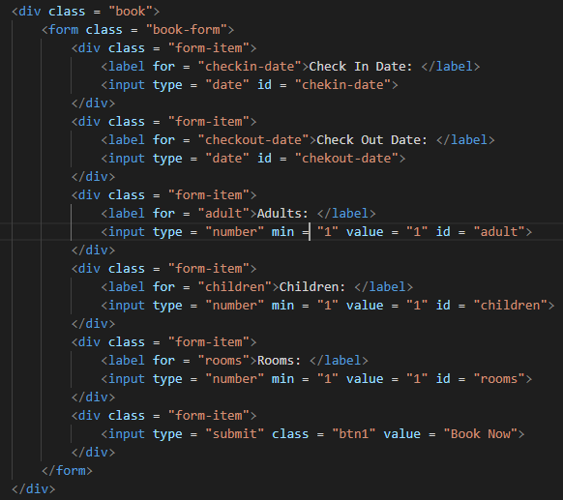
HTML
I use HTML to :
Have the structure of my website
Make 3 parties : HEAD, MAIN and FOOTER
Insert images, paragraphs, forms,…
Link my .css and .js files

Slide 3
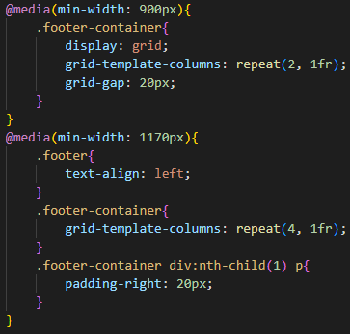
CSS
I use CSS to :
design My website
Make it responsive

Slide 4
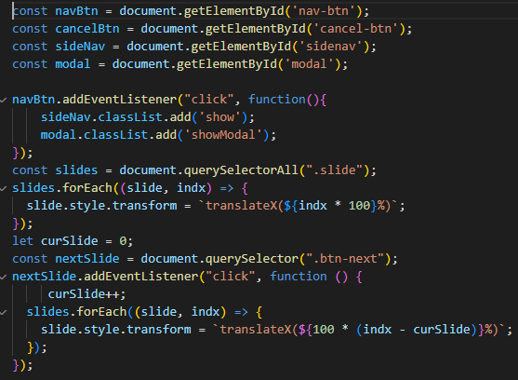
Javascript
I use JavaScript to :
Make my website dynamic
Create a carousel
To validate the input of the form

